Slide 1

Temple Management System 2.0 - Omkaar Temple
Team Members : Vamsi Krishna Rolla ,Ganesh Karnati , Arundhati Bidwe

Slide 2

Project Proposal
Introduction to System 2.0: "Omkaar Temple Management System 2.0 marks a significant evolution, enhancing functionalities based on user feedback.“
Purpose: "Aims to optimize experiences for devotees, priests, and administrators, supporting spiritual and communal activities.“
Goals: "Improve digital engagement, ensure efficient and secure service delivery, streamline temple operations through advanced technology."

Slide 3
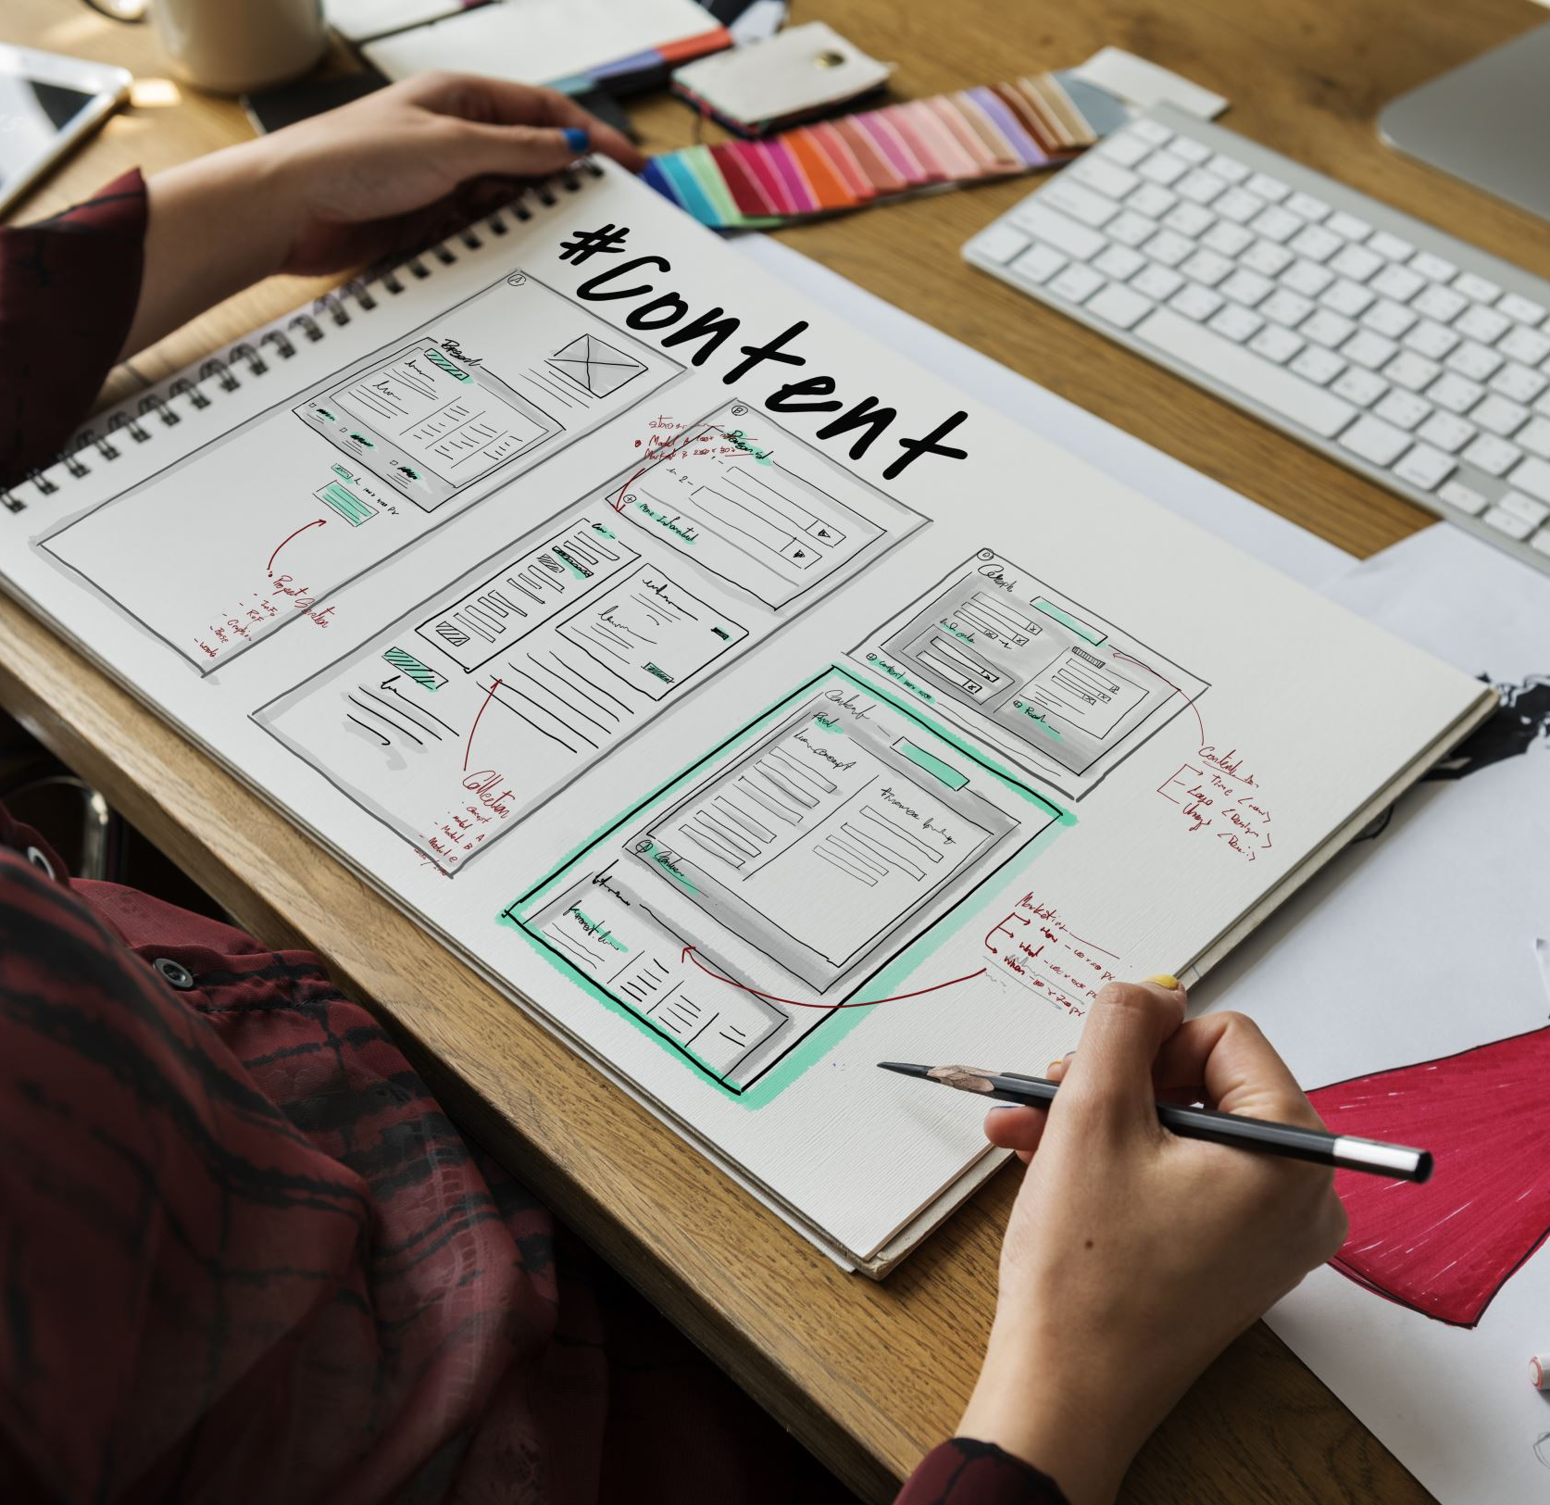
Software Design
Use Case Diagram
State Diagrams
Sequence Diagrams
Class Diagram

Slide 4
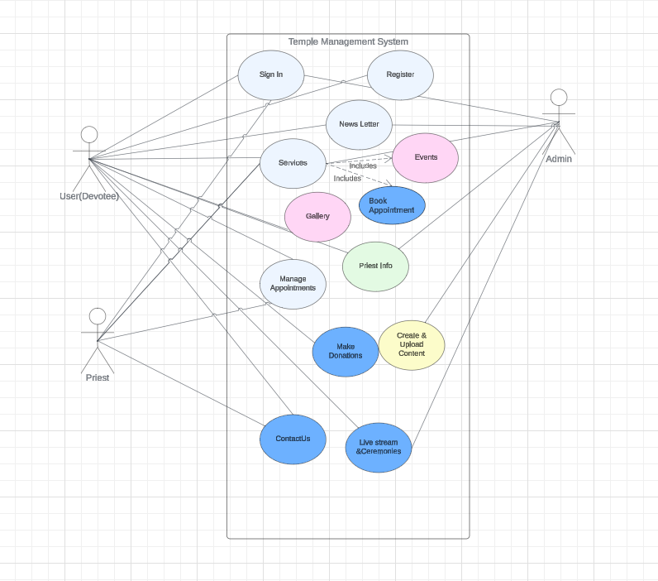
Use Case diagram

Slide 5
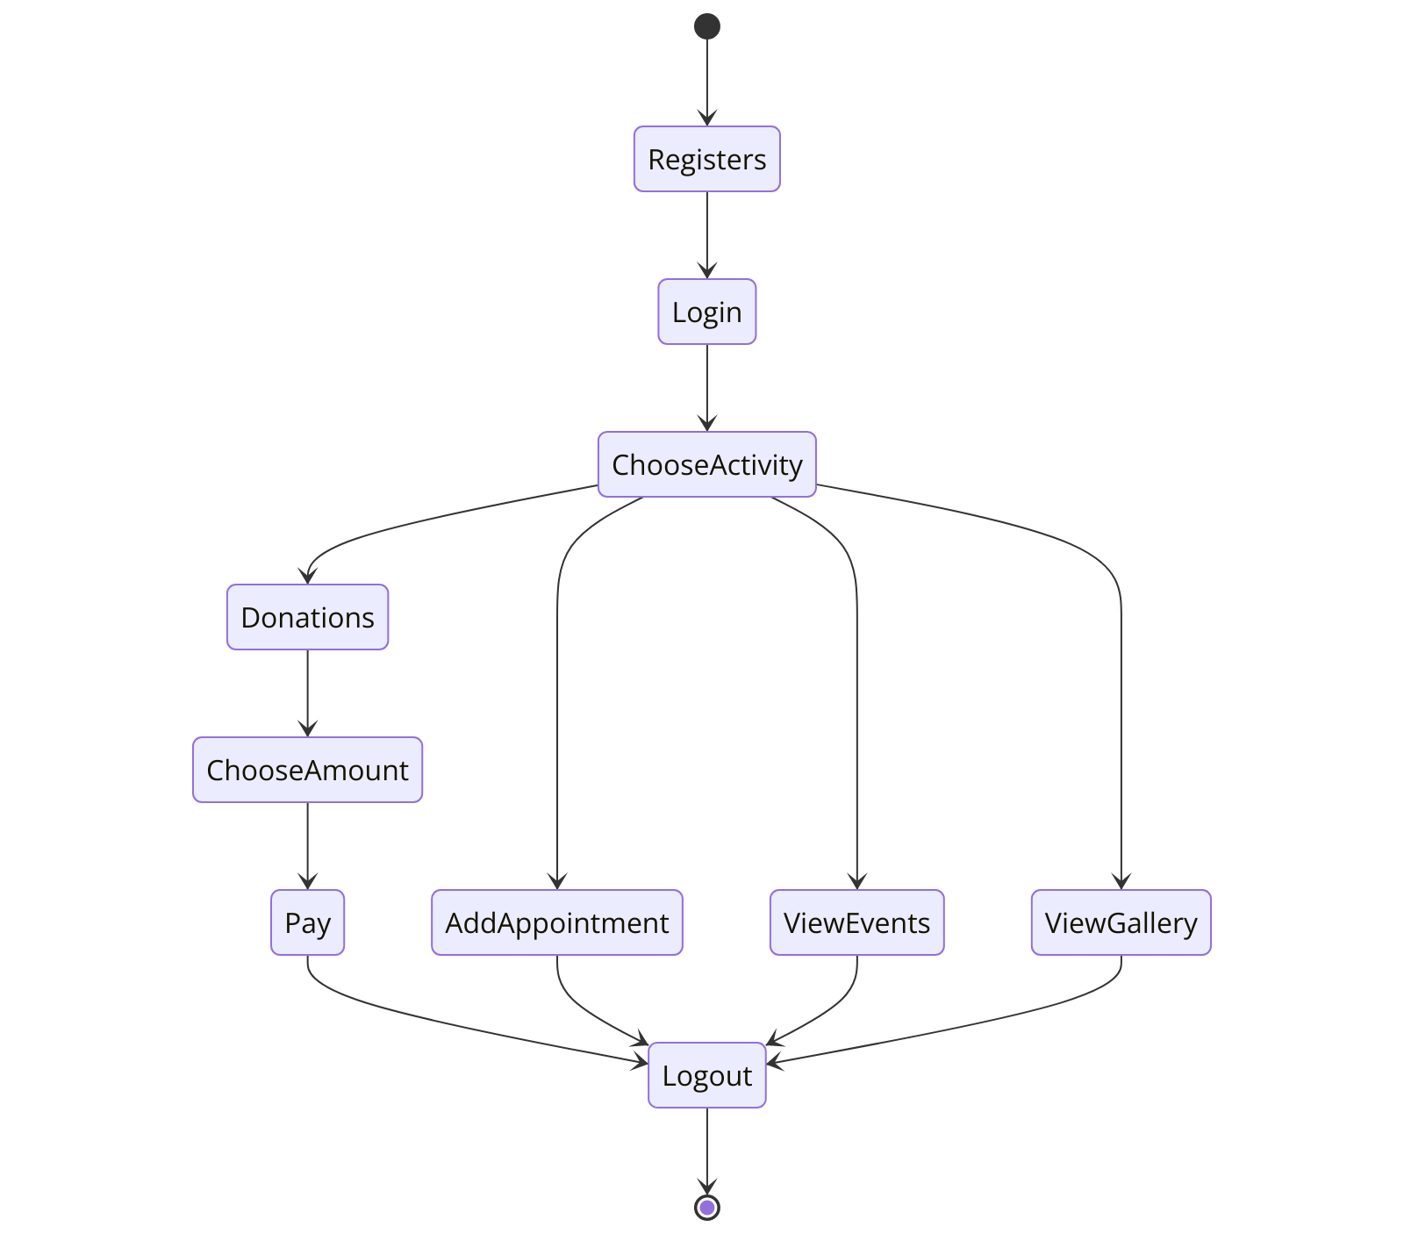
Devotee Login

Slide 6
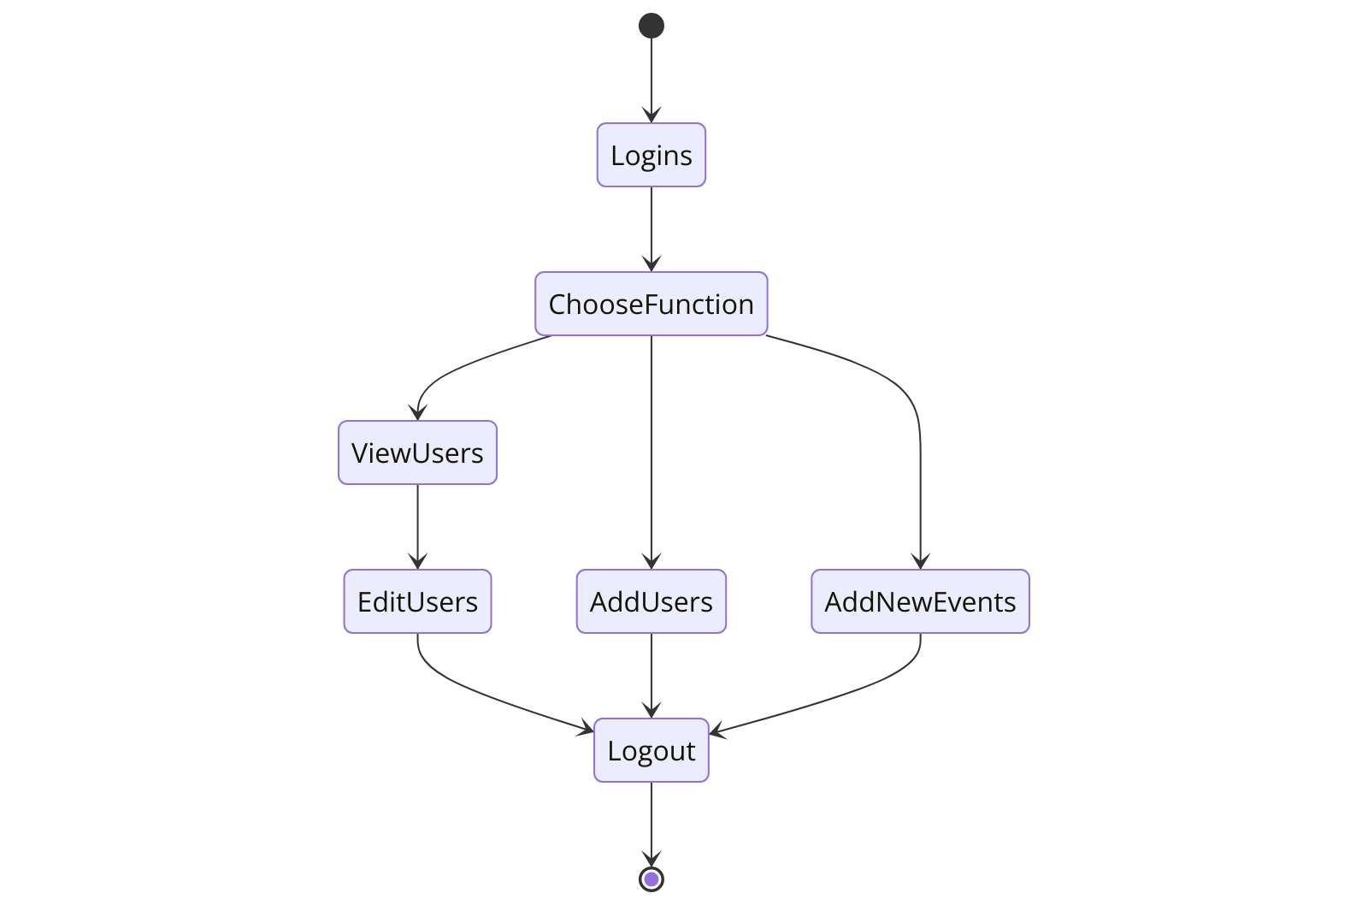
Admin Login

Slide 7
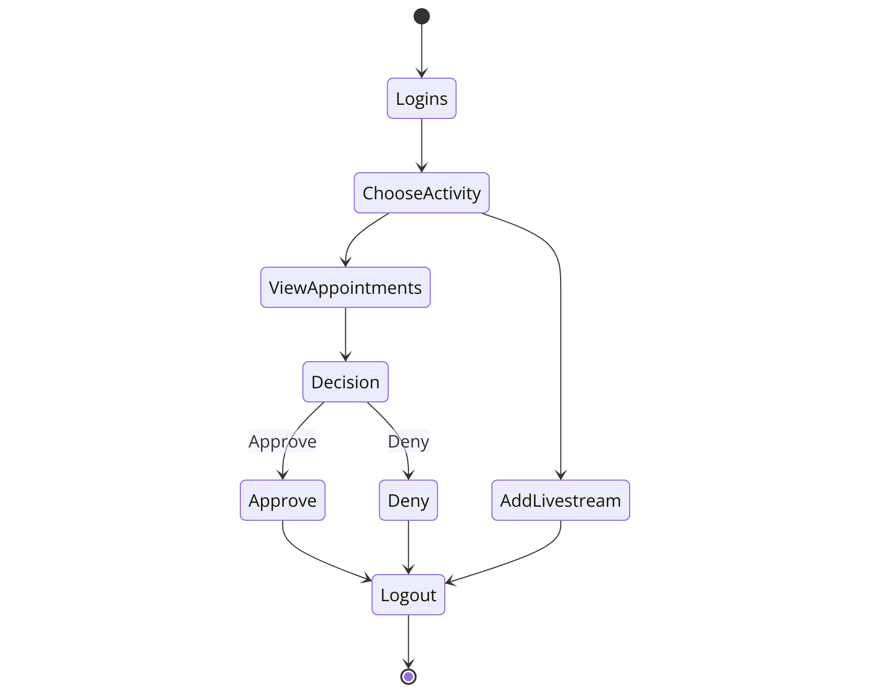
Priest Login

Slide 8
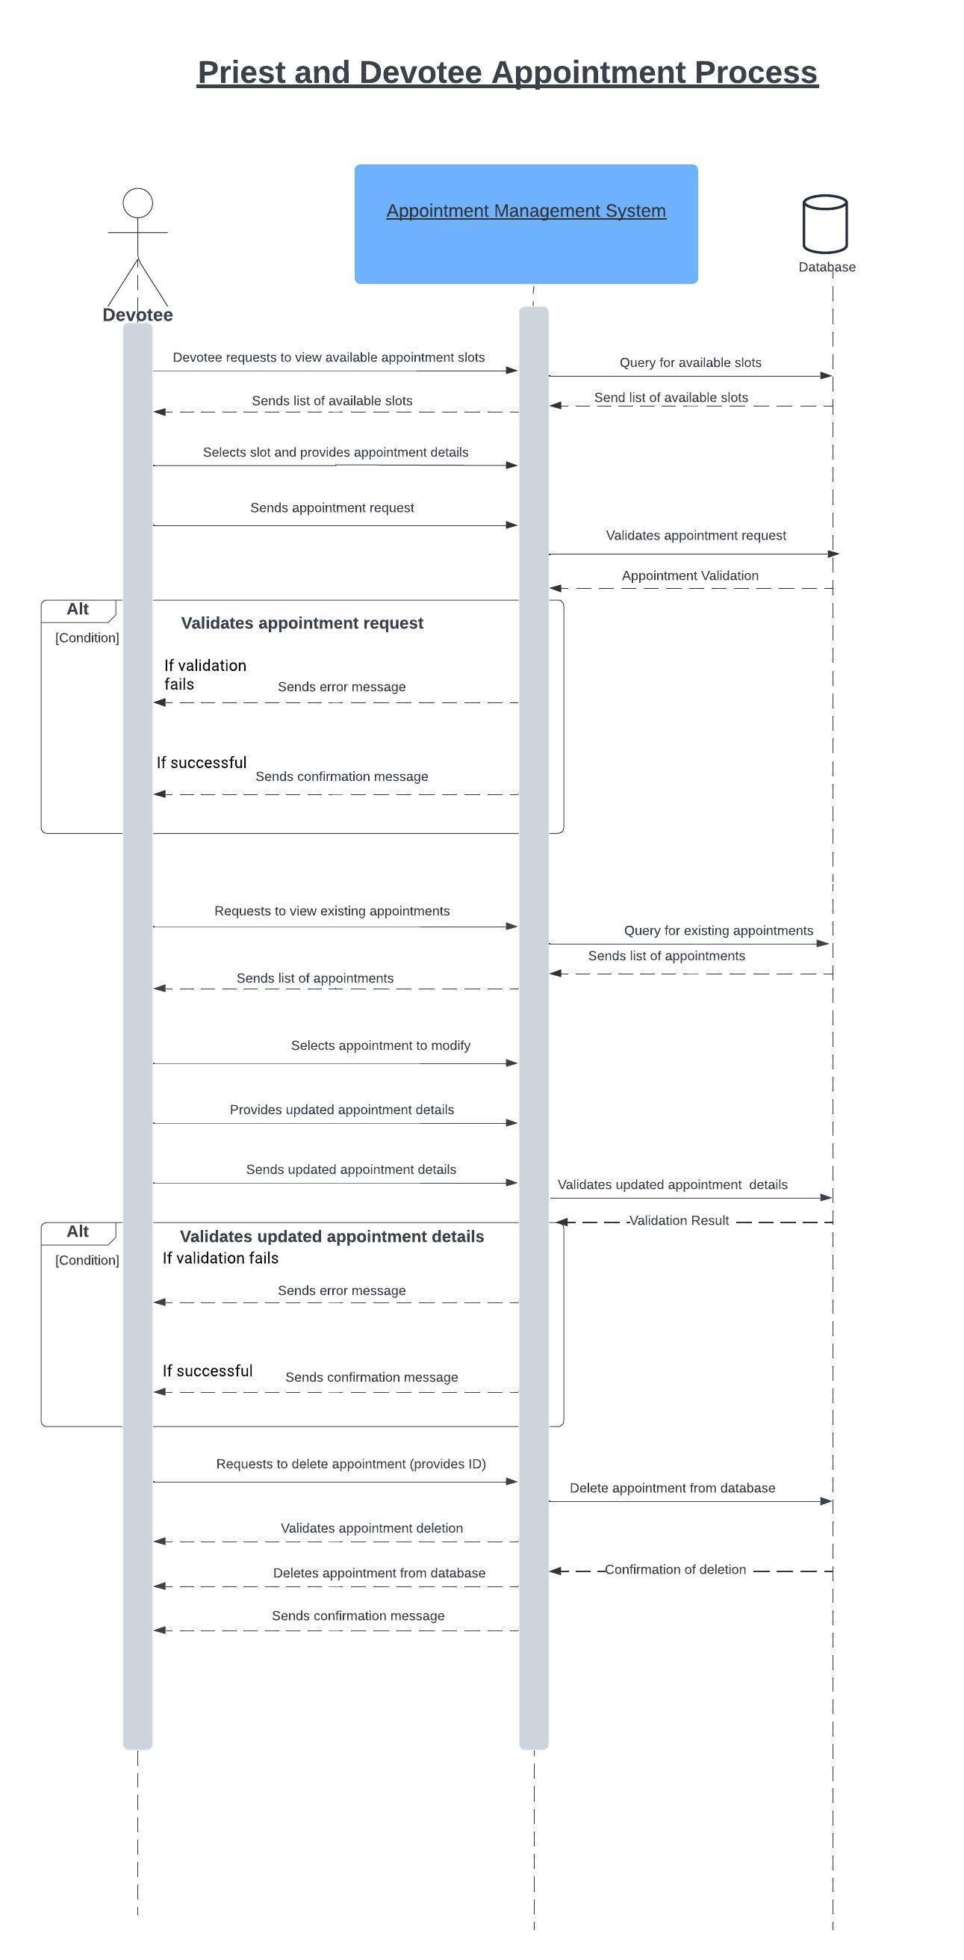
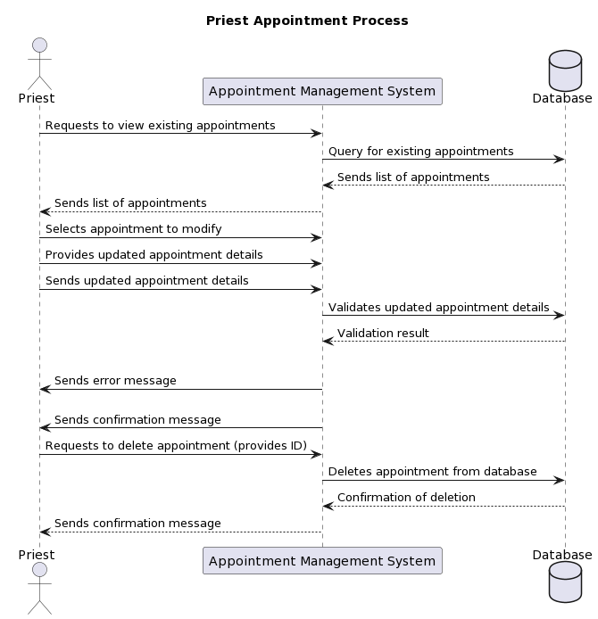
Appointment Sequence Diagram

Slide 9
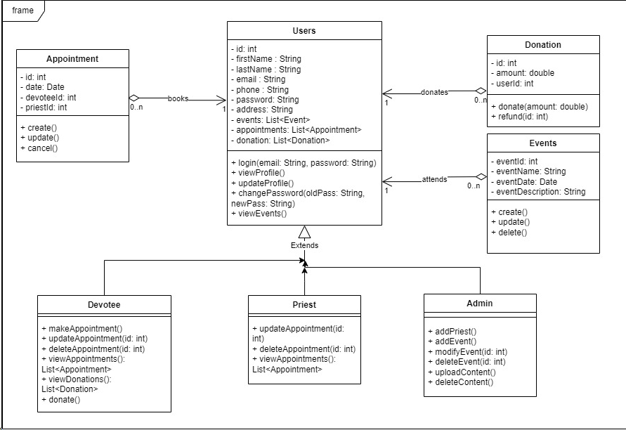
Class Diagram

Slide 10

Demo

Slide 11
Requirements
User-Centric Design:
Technical Specifications:
"Performance: Optimized for high traffic, especially during peak festival times.“
"Scalability: Engineered to accommodate growing user base without loss of performance.“
"Reliability and Usability: High uptime and intuitive user interfaces for all age groups."​
"Streamlined donation management and booking systems.“
"Real-time communication for immediate updates and notifications."

Slide 12




Tools Used
Development Environment:
Backend Technologies:
"Visual Studio Code: Chosen for its robust features like debugging, task running, and native support for many programming languages."
"GitHub: Ensures efficient collaboration among developers with version control and code sharing capabilities."
"NodeJS: Powers the server-side with its efficient and scalable network applications."
"Express: A web application framework for Node.js, designed for building web applications and APIs."
Database Management:
Design and Prototyping Tools:
"MongoDB Atlas: Utilized for its scalability and flexibility, perfect for handling large volumes of unstructured data."
"Figma: Enables the design of high-fidelity interactive prototypes accessible across the development team."
"Lucid Chart and Draw.io: Tools used for creating clear and detailed UML diagrams and architectural visualizations."

Slide 13
Risks and Solutions
"Risk: Scope creep affecting timelines and budgets."
"Solution: Strict change control and regular scope reviews.“
Technological Adaptation:
"Risk: Delays due to new technology integration.“
"Solution: Pre-implementation training and pilot testing.“
Data Security:
"Risk: Potential data breaches."
"Solution: Encryption, regular audits, and secure access protocols."​

Slide 14
Project Management-Agile Methodology
Sprint Planning
1
The project follows an Agile methodology, with regular sprint planning sessions to ensure adaptive and iterative development.
2
Iterative Feedback
Stakeholder feedback is continuously incorporated through an iterative process, enabling the system to evolve and meet evolving needs.
Collaborative Approach
3
The team collaborated closely, leveraging daily stand-ups and open communication to address challenges and drive progress.

Slide 15




Lasting Impact
Enhanced Experiences
The Temple Management System 2.0 delivers a transformative impact, optimizing experiences for devotees, priests, and administrators.
Efficient Operations
The system streamlines temple operations, enabling more effective service delivery and strengthening the spiritual community.
Continuous Improvement
The project's Agile approach and commitment to learning ensure the system remains relevant and continues to evolve over time.

Slide 16
References :
Class Notes
Figma official website: https://www.figma.com/
React official website: https://reactjs.org/
NodeJS official website: https://nodejs.org/en/
ExpressJS official website: https://expressjs.com/

